Slide 1



Work Item Types (WITs)

Slide 2






Work Item Types
Epics can be defined as a large piece of work that has one common objective.
Tracks a feature that will be released with the product
Tracks an activity the user will be able to perform with the product
Issues track suggested improvements, changes or questions related to the project. Tracks an obstacle to progress.
Tracks work that needs to be done.
Describes a divergence between required and actual behavior

Slide 3





Work Item Types
Tracks an activity the user will be able to perform with the product.
Includes information to track changes through the MSF for CMMI Process Improvement life cycle
Includes information to track the requirement through the MSF for CMMI Process Improvement life cycle
This work item tracks reviews and the results.
Includes information to track the work to mitigate a risk.

Slide 4
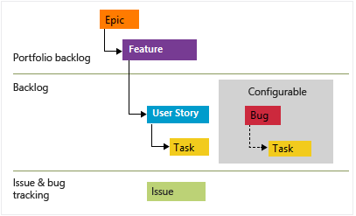
WITs – Agile Process

Slide 5
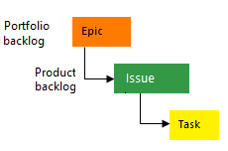
WITs – Basic Process

Slide 6
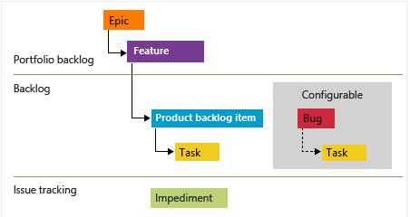
WITs – Scrum Process

Slide 7
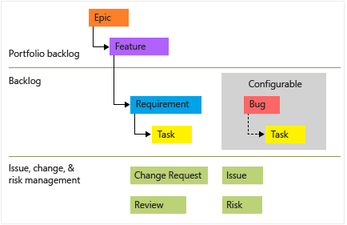
WITs – CMMI Process

